Slide 1
Convolutional Neural Network Basics

Slide 2
Images
Images are loaded as matrix/tensor in python. Each element represents pixel level information of the image.
Two color models:
RGB: additive color mixing, stores light values for red, green and blue
CMYK: subtractive color mixing model, stores ink values for cyan, magenta, yellow and black

Slide 3
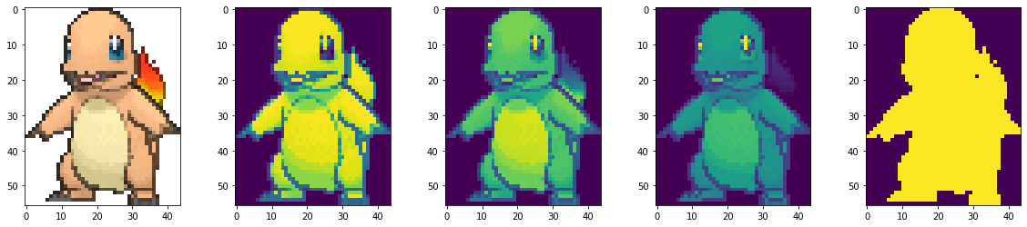
Images
A Charmander figure with the dimension of 56*44*4, which will be used later in the localization
56 pixel * 44 pixel * 4 channels
Original
Red
Green
Blue
Alpha (transparency)

Slide 4
Fundamental Problems
With the input image as a matrix/tensor, most computer vision problems involving
Image classification
Recognition
Image segmentation
Localization
Object detection

Slide 5
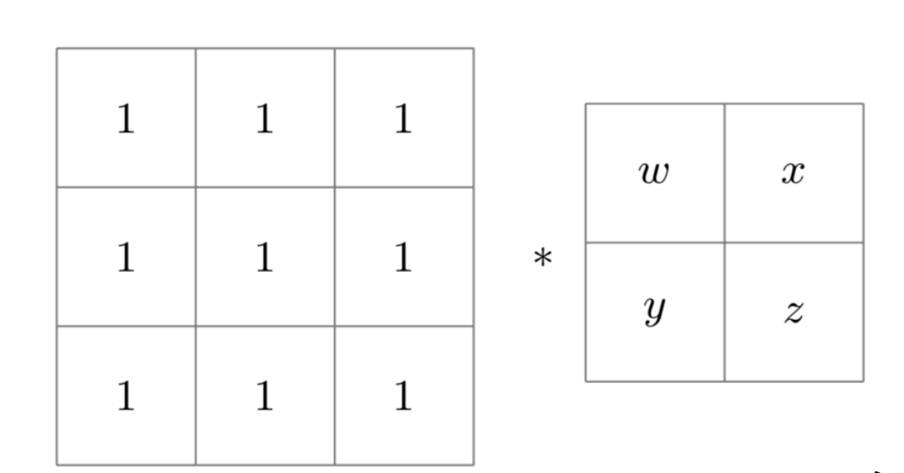
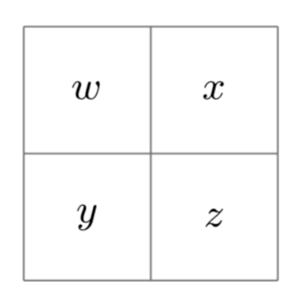
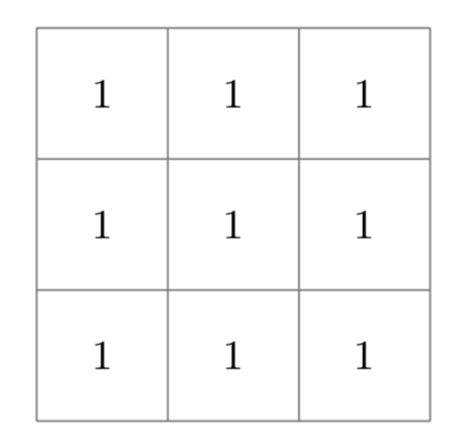
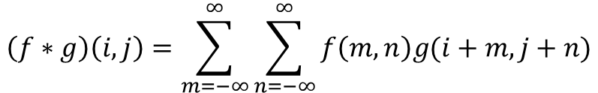
Convolution
The convolution between $f\left(x,y\right)$ and $g\left(x,y\right)$
$$\left(f∗g\right)\left(i,j\right)=\sum_{m=−∞}^{∞}{\sum_{n=−∞}^{∞}{f\left(m,n\right)g(i+m,j+n)}}$$
$$=$$
Input
Filter
Output

Slide 6


Why Convolutional Layer Works
The convolution projects the images to feature maps, containing different components of the image. E.g. edges, corners, etc.
10 | 10 | 10 | 0 | 0 | 0
10 | 10 | 10 | 0 | 0 | 0
10 | 10 | 10 | 0 | 0 | 0
10 | 10 | 10 | 0 | 0 | 0
10 | 10 | 10 | 0 | 0 | 0
10 | 10 | 10 | 0 | 0 | 0
0 | 30 | 30 | 0
0 | 30 | 30 | 0
0 | 30 | 30 | 0
0 | 30 | 30 | 0
1 | 0 | -1
1 | 0 | -1
1 | 0 | -1
$$∗$$
$$∗$$

Slide 7
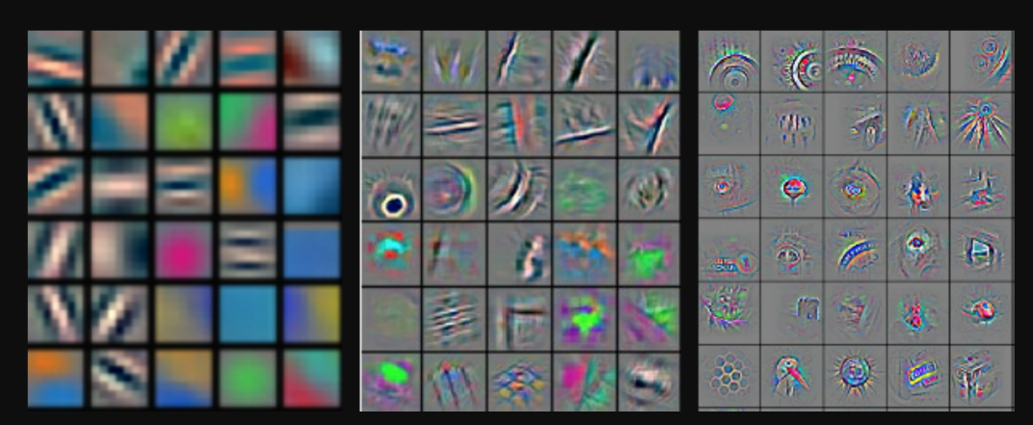
Why Convolutional Layer Works
The convolution projects the images to feature maps, containing different components of the image.
Earlier layers’ receptive fields capture local patterns, and higher layers’ receptive fields capture global patterns

Slide 8
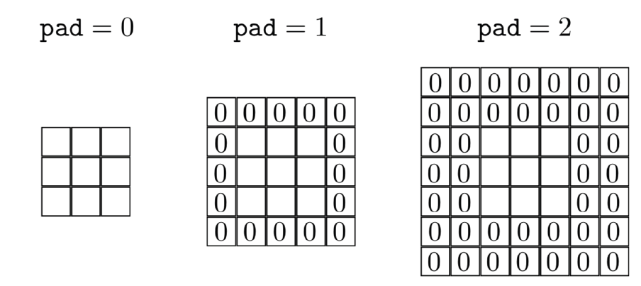
Convolutional Padding
Convolution will reduce the output size. Adding zero paddings to the matrix will make the output remain the same size.

Slide 9
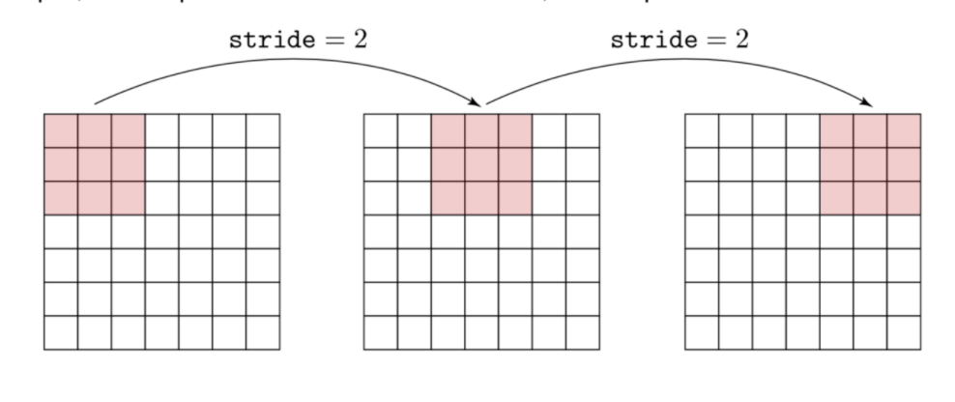
Stride
Stride defines how the filters move in the convolution. Reduce the repeated computation.

Slide 10
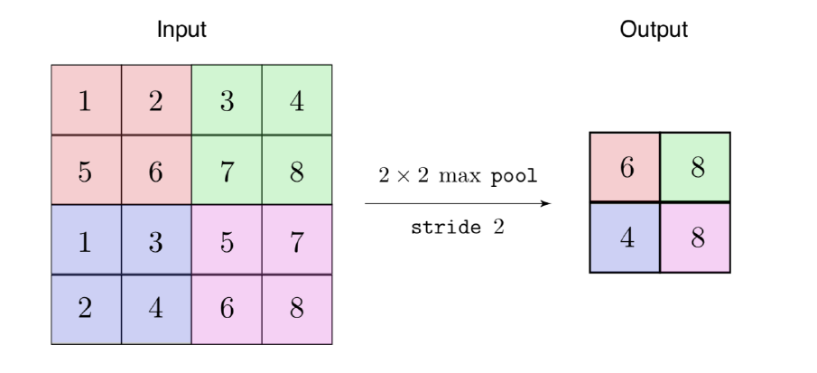
Pooling Layer
Pooling layer down-samples the matrix.
Max, average or sum pooling. Most general option is max pooling. No backward propagation needs to be calculated.

Slide 11
Transfer Learning

Slide 12
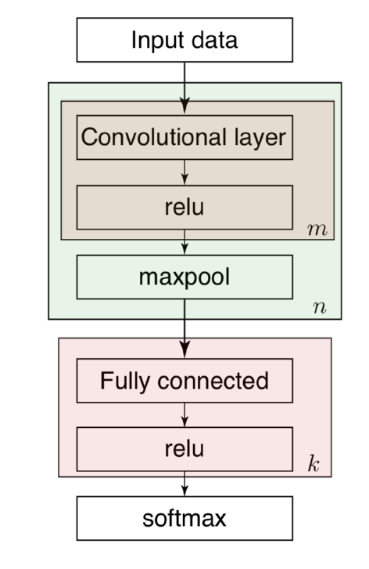
Basics
Deep convolutional neural network is generally consisting of multiple convolutional layer, pooling layer, and eventually fully connected layer and prediction layer.
Large number of parameters are involved in the model. Each time training a new model from the beginning is computationally expensive.

Slide 13
Basics
Use the pre-trained parameters.
Retrain the weight of the last layer for the particular problem we are dealing with.
We can also stack the output to create multi-task model

Slide 14
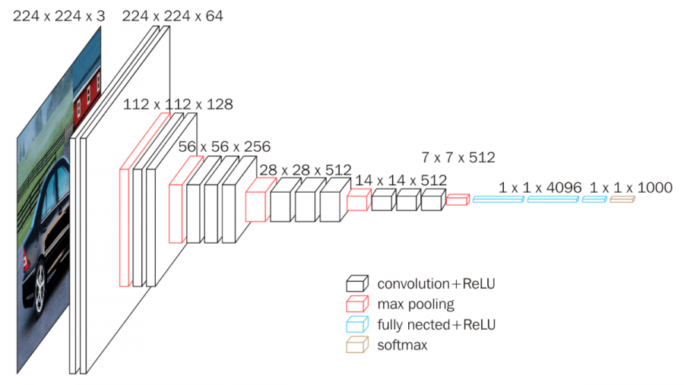
VGG Net
• Total memory: 24M * 4 bytes = 96MB for one forward pass.
• Total parameters: 138M parameters

Slide 15
Hands On Localization Project

Slide 16
Step by Step Project
Localize a white box on the dark background
Localize Charmander on the dark background
Localize Charmander with resizing on the dark background
Localize Charmander with resizing and flipping on the dark background
Localize Charmander with resizing and flipping on colorful background
Localize and classify a pokemon with resizing and flipping on colorful background

Slide 17
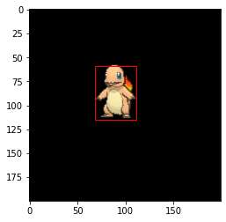
Objective
Predict the location of an object in an image -> regression problem
Input: image -> output: a bounding box showing the location of an object

Slide 18
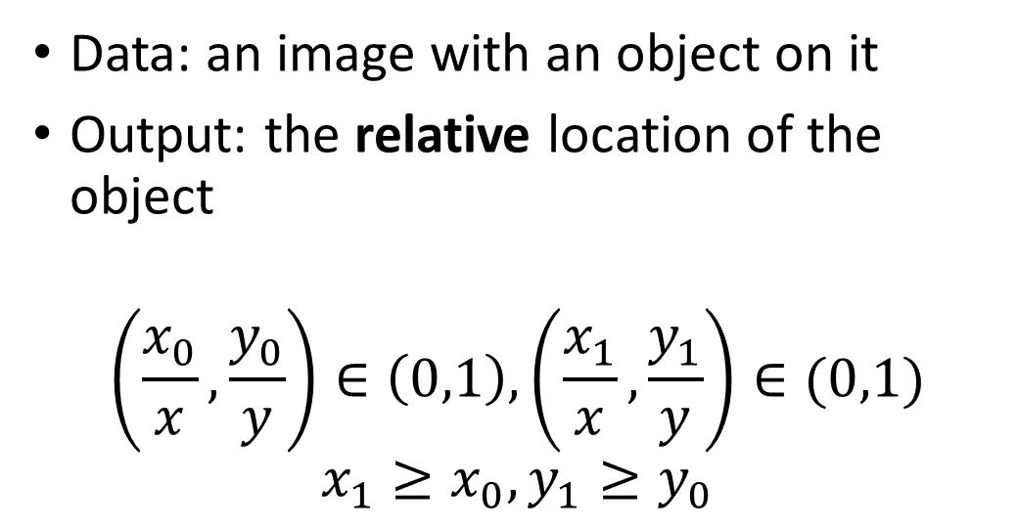


Problem Formulation
x
Data: an image with an object on it
Output: the relative location of the object
$$\left(\frac{x_{0}}{x},\frac{y_{0}}{y}\right)∈\left(0,1\right),\left(\frac{x_{1}}{x},\frac{y_{1}}{y}\right)∈(0,1)$$
$$x_{1}≥x_{0}, y_{1}≥y_{0}$$
$$(x_{0},y_{0})$$
y
$$(x_{1},y_{1})$$

Slide 19
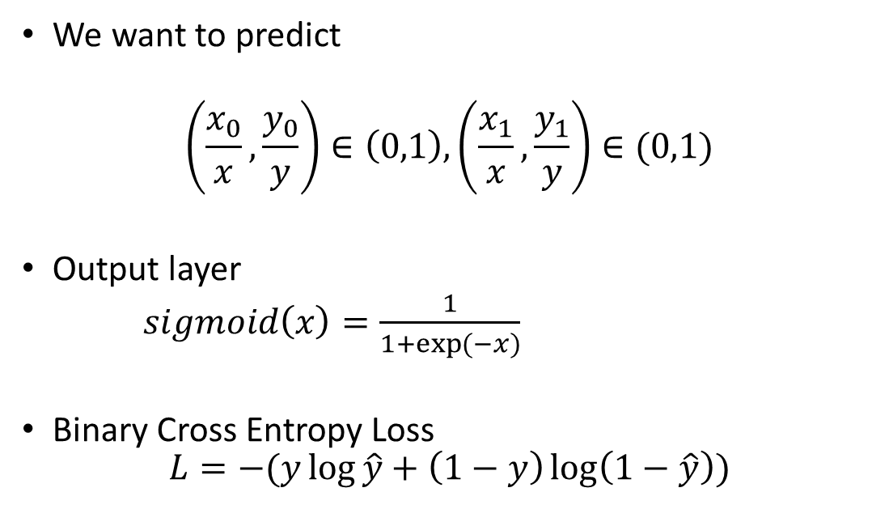


Loss Function
x
We want to predict
$$\left(\frac{x_{0}}{x},\frac{y_{0}}{y}\right)∈\left(0,1\right),\left(\frac{x_{1}}{x},\frac{y_{1}}{y}\right)∈(0,1)$$
Output layer
$sigmoid\left(x\right)=\frac{1}{1+\exp{(−x})}$
Binary Cross Entropy Loss
$$L=−(y\log{\hat{y}}+\left(1−y\right)\log\left(1−\hat{y}\right))$$
$$(x_{0},y_{0})$$
y
$$(x_{1},y_{1})$$

Slide 20
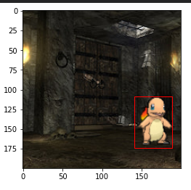
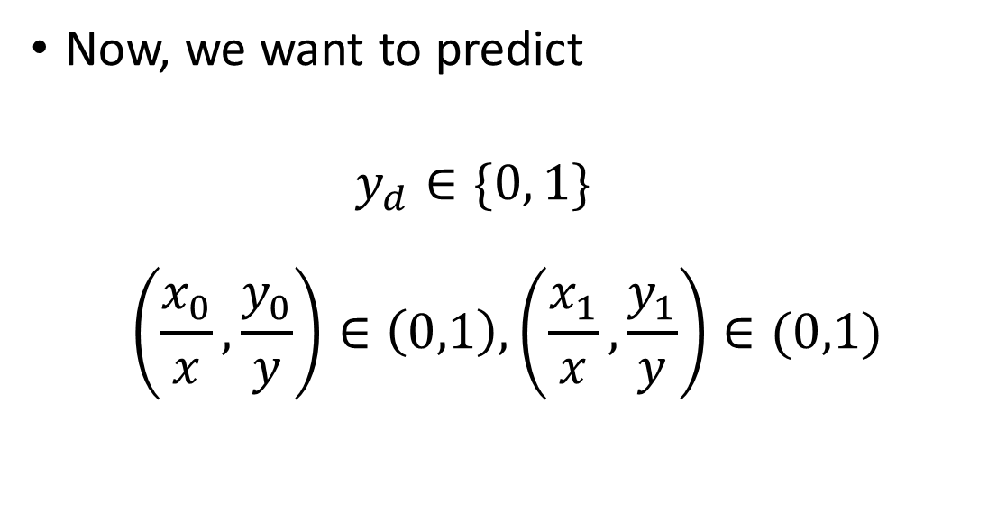



What if the Charmander doesn’t show
x
Now, we want to predict
$$y_{d}∈\{0, 1\}$$
$$\left(\frac{x_{0}}{x},\frac{y_{0}}{y}\right)∈\left(0,1\right),\left(\frac{x_{1}}{x},\frac{y_{1}}{y}\right)∈(0,1)$$
$$y_{d}=1$$
$$(x_{0},y_{0})$$
y
$$(x_{1},y_{1})$$

Slide 21
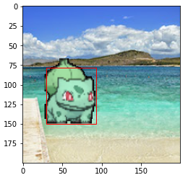
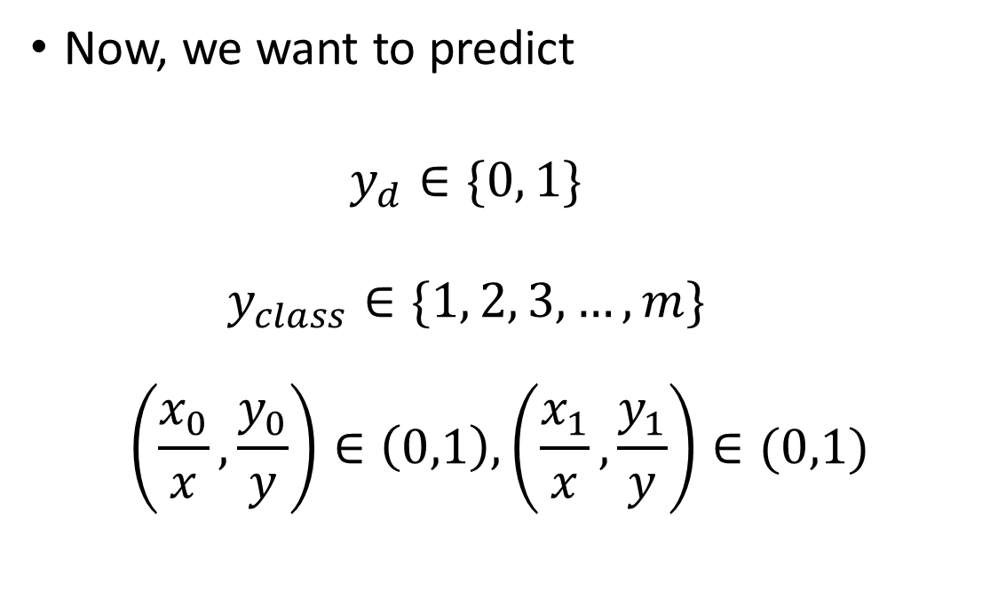




What about multi-class classification
x
Now, we want to predict
$$y_{d}∈\{0, 1\}$$
$$y_{class}∈\{1, 2, 3, …, m\}$$
$$\left(\frac{x_{0}}{x},\frac{y_{0}}{y}\right)∈\left(0,1\right),\left(\frac{x_{1}}{x},\frac{y_{1}}{y}\right)∈(0,1)$$
$$y_{d}=1$$
$$y_{class}=[0, 1, 0]$$
$$(x_{0},y_{0})$$
y
$$(x_{1},y_{1})$$

